Slide 1



Using Specification and Description Language to define and implement discrete simulation models
2010 Summer Simulation Multiconference (SummerSIM'10)
July 11 - 15, 2010
Crowne Plaza; Ottawa, ON, Canada

Slide 2
Why?
“There are, however, many major challenges currently facing the simulation community. As the power of available computers increases dramatically, so does their potential limited only by our ability to harness that power effectively.
The need to simulate ever larger and more complex systems,
the need to better allow for uncertainty in our models,
the need to develop ultra-fast real-time simulations,
the need to develop simulation tools that can be used by large multi-disciplinary teams of designers,
the need to develop simulations of systems that include human behavior,
are just a few of the grand challenges facing us.“
Roy Crosbie
Grand Challenges in Modeling and Simulation SCS M&S Magazine – 2010-01 (January)

Slide 3
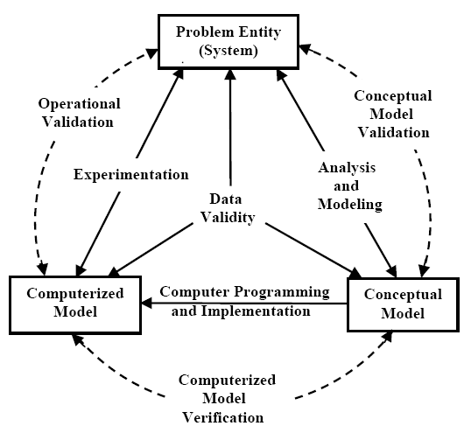
VV&A
Sargent R.

Slide 4
Outline
Specification and Description Language
Proposed extensions
A simple model
SDL/XML
SDLPS
Concluding remarks
SDL – SIGNAL DELAY – GG2 – SDL/XML – SDLPS – Concluding remarks

Slide 5
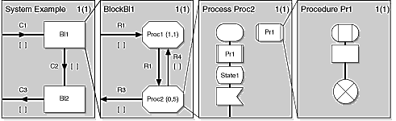
Modular
SDL – SIGNAL DELAY – GG2 – SDL/XML – SDLPS – Concluding remarks

Slide 6
Structure
SDL – SIGNAL DELAY – GG2 – SDL/XML – SDLPS – Concluding remarks

Slide 7
Behaviour
SDL – SIGNAL DELAY – GG2 – SDL/XML – SDLPS – Concluding remarks

Slide 8
Graphical and no graphical:
SDL/GR and SDL/PR
 | process P; start; nextstate idle; state idle; input s; output t; nextstate idle; endstate idle; endprocess P;
SDL – SIGNAL DELAY – GG2 – SDL/XML – SDLPS – Concluding remarks

Slide 9
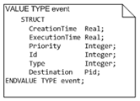

DELYING SIGNALS
These extensions are now under discussion on the ITU-T Study Group 17 (http://www.itu.int/ITU-T/studygroups/com17/index.asp) to be included in the next release of the standard.
SDL – SIGNAL DELAY – GG2 – SDL/XML – SDLPS – Concluding remarks

Slide 10
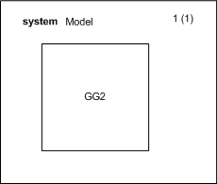
The model
SDL – SIGNAL DELAY – GG2 – SDL/XML – SDLPS – Concluding remarks

Slide 11
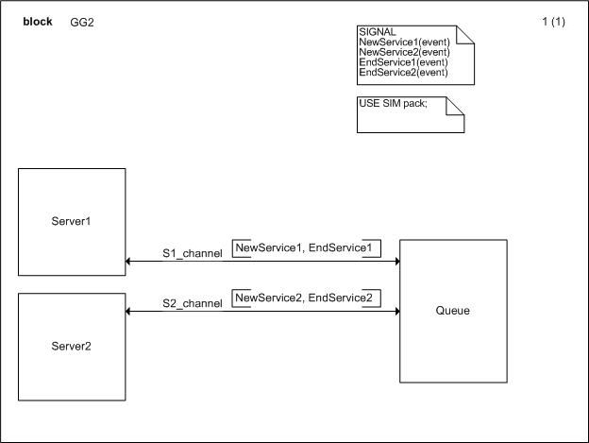
The model
SDL – SIGNAL DELAY – GG2 – SDL/XML – SDLPS – Concluding remarks

Slide 12
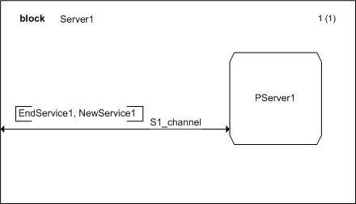
The model
SDL – SIGNAL DELAY – GG2 – SDL/XML – SDLPS – Concluding remarks

Slide 13
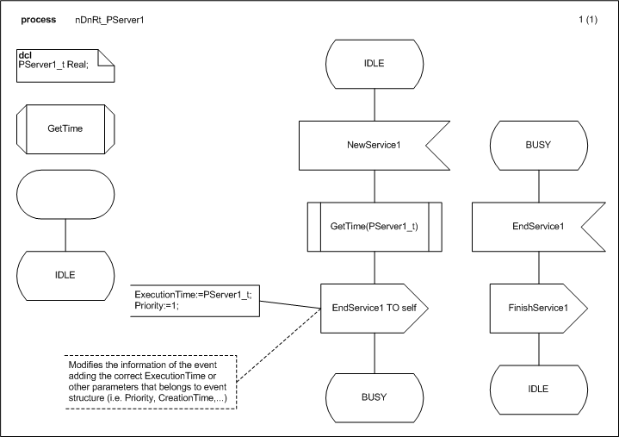
The model
SDL – SIGNAL DELAY – GG2 – SDL/XML – SDLPS – Concluding remarks

Slide 14
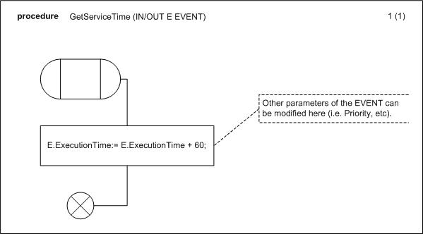
The model
SDL – SIGNAL DELAY – GG2 – SDL/XML – SDLPS – Concluding remarks

Slide 15
SDL/XML
<channels>
<channel name="MainS1" start="BlockServer1" end="BlockQueue" dual="yes">
<!--The events that use the channel.-->
<event name="FinishService1"></event>
<event name="NewService1"></event>
</channel>
<channel name="MainS2" start="BlockServer2" end="BlockQueue" dual="yes">
<!--The events that use the channel.-->
<event name="FinishService2"></event>
<event name="NewService2"></event>
</channel>
</channels>
SDL – SIGNAL DELAY – GG2 – SDL/XML – SDLPS – Concluding remarks

Slide 16
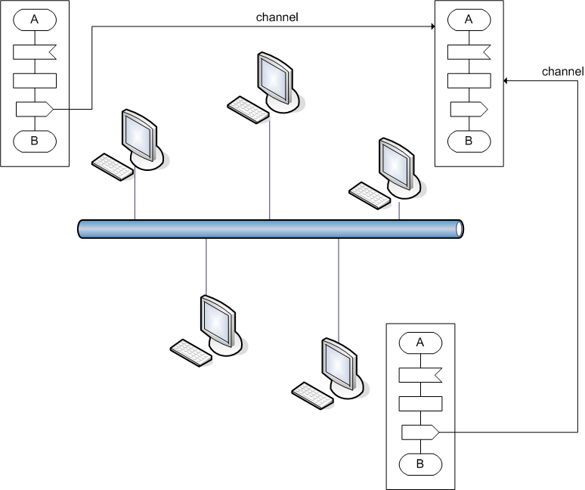
SDLPS
SDL – SIGNAL DELAY – GG2 – SDL/XML – SDLPS – Concluding remarks

Slide 17
SDLPS Arquitecture
Process
SDL process blocks
C++ native code
Procedures
SDL procedures blocks
Tasks and decisions code
SDLCode.dll
C++ native code
SDL – SIGNAL DELAY – GG2 – SDL/XML – SDLPS – Concluding remarks

Slide 18
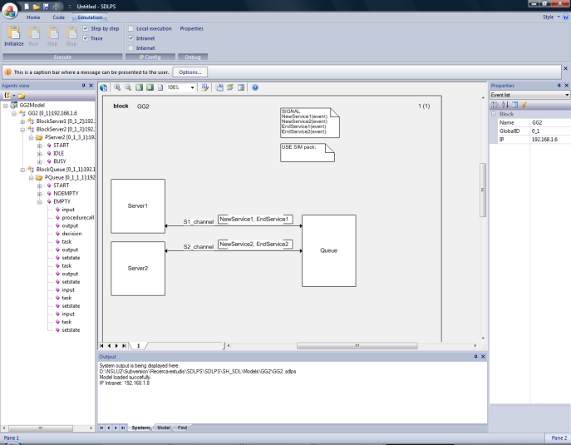
SDLPS GUI
SDL – SIGNAL DELAY – GG2 – SDL/XML – SDLPS – Concluding remarks

Slide 19
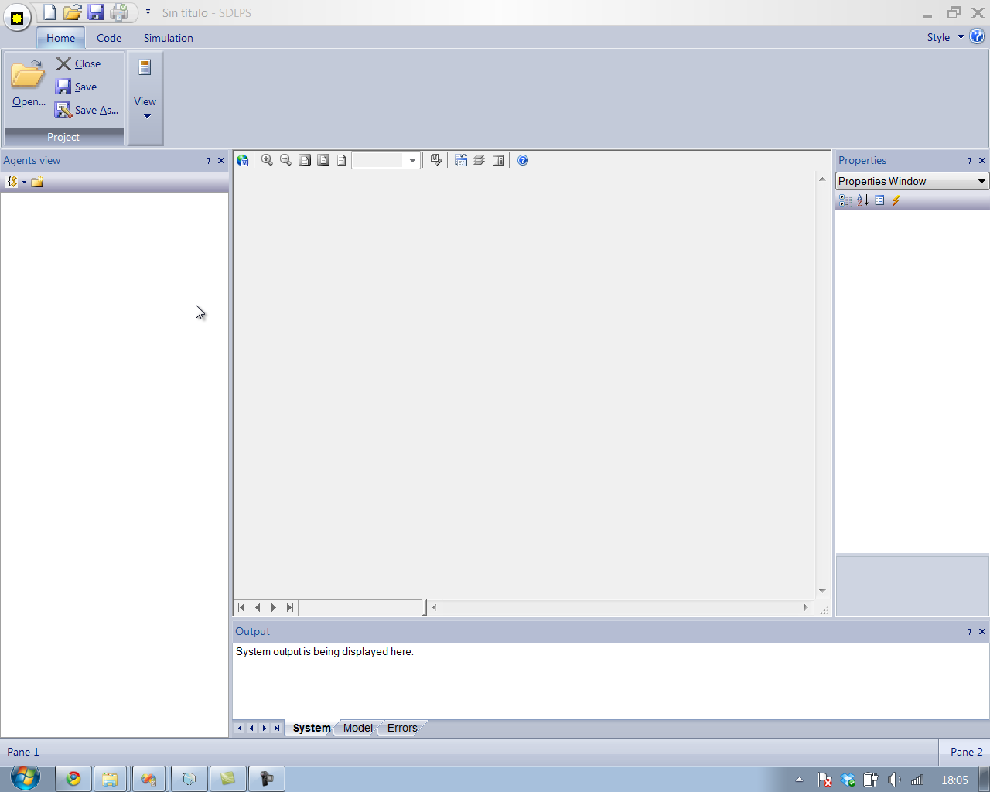
The GG2 model

Slide 20
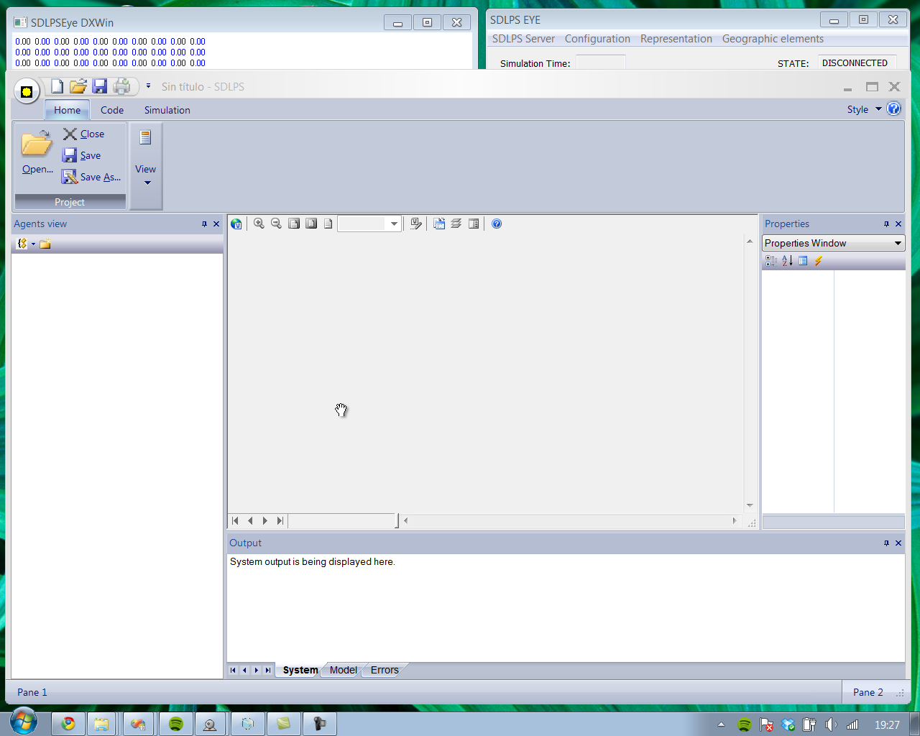
The Fibonacci model

Slide 21
Concluding remarks
Capable to perform a simulation of a model represented using Specification and Description Language.
  A solution to manage time in SDL is proposed, adding event structure to all SDL signals.
SDL/XML is presented.
  We use SDL/XML instead SDL/PR because XML simplifies the manipulation of the model representation in SDLPS.
  SDL/XML representation allows the definition of elements implemented using a DLL or C++ classes, allowing the use of legacy simulation models or other elements that we don’t want to represent in the specification of the model.
This infrastructure allows a distributed simulation of the different elements defined in SDL.
  SDLPS manages the time and the resources needed to execute the simulation. The user only must describe the behavior of the model following SDL, without the need of think if the execution will be local or shared over different computers.
SDL – SIGNAL DELAY – GG2 – SDL/XML – SDLPS – Concluding remarks

Slide 22
Concluding remarks
Not all the structures are implemented.
  We do not have an implementation of Timers, and the events cannot carry other parameters than simple types (structures are not allowed yet, with the exception of event structure reviewed in this paper).
  In future releases of SDLPS we plan to add fully compliance to SDL 2000 and the future release of the standard SDL.
This methodology has been used during several years successfully. As an example of the application of this methodology we can mention the simulation of the ALMIRALL PRODESFARMA enterprise, or the simulation of the BARCELONA INTERNATIONAL AIRPORT. More recently and using the infrastructure we can mention, in the environmental area, the wildfire or slap avalanches modeling, and in the industrial area the ongoing project with ARBORA & AUSONIA enterprise.
SDL – SIGNAL DELAY – GG2 – SDL/XML – SDLPS – Concluding remarks

Slide 23
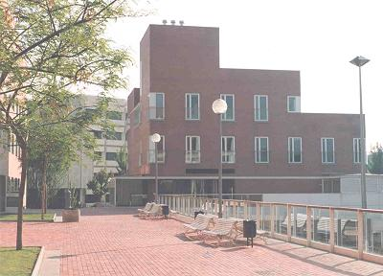
Gràcies!
  Pau Fonseca i Casas
  pau@fib.upc.edu
  http://www-eio.upc.es/~pau
  Technical University of Catalonia
  Barcelona School of Informatics Computing laboratory
  Barcelona
  Jordi Girona 1-3
  (+34)93401773

Slide 24
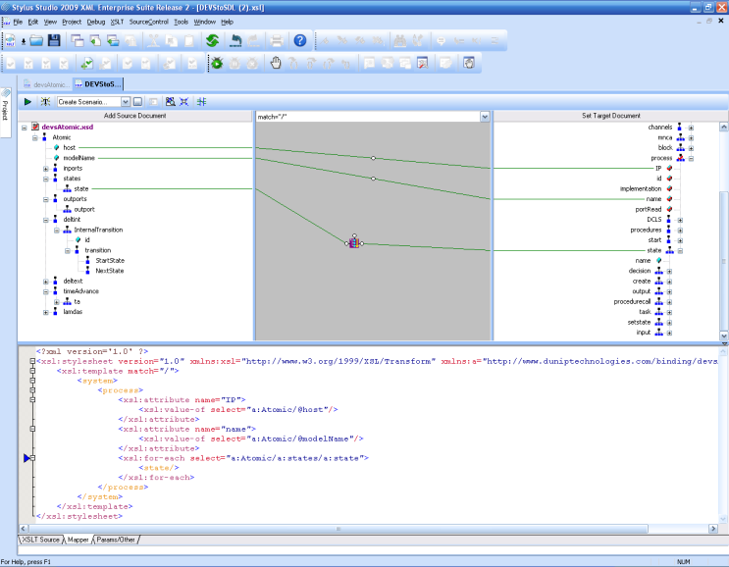

... Using with DEVS
SummerSim 2009
Towards an automatic transformation from a DEVS to a SDL specification.
Procediings of the 2009 Summer Simulation Multiconference.
July 13-16, 2009 Grand Cevahir Hotel and Convention Center Istanbul, (TURKEY)

